Slide 1

Changes in Gut microbiota abundance With dietary intervention
By Daniel Broderick

Slide 2
Content
What is the microbiome and why is it important?
The study
The data
Hypotheses
Analysis
Discussion

Slide 3
The microbiome
Human microbiome project started in 2008
Our guts have ~20,000 orthologous groups of bacteria, less than 5,000 of which are known, even fewer have their functions characterized in the literature [1]
Responsible for digesting fiber and indigestible short-chain carbohydrates [2]
FODMAPs - low–fermentable oligo-, di-, and monosaccharide and polyol
Implicated in in food intolerance and IBS
Breakdown by gut bacteria can produce gas, bloating, etc.
Gluten produces an inflammatory response in the gut [3]
Microbiome composition is shaped by diet, but also by mode of delivery (vaginal or caesarean), lifestyle factors, and antibiotic use (especially during infancy) [4]
May also be implicated in autoimmunity, mental illness, Alzheimer’s, Crohn’s, etc.

Slide 4
The study
n = 78
Obese individuals
Lasts 12 weeks
3 dietary interventions
Study A (n = 28) and B (n=24) eats gluten-containing foods; whole grains or low-fiber, refined wheat bread; from Finland
Study C (n = 13) consumes 8g inulin and 8g oligofructose daily; from Belgian
Study D (n=13) has a one-week run-in diet followed by three weeks each of a resistant-starch-enriched, non-starch-polysaccharide-enriched, and low carb/fat, high pro; from Britain
Collect fecal samples pre- and post-intervention

Slide 5
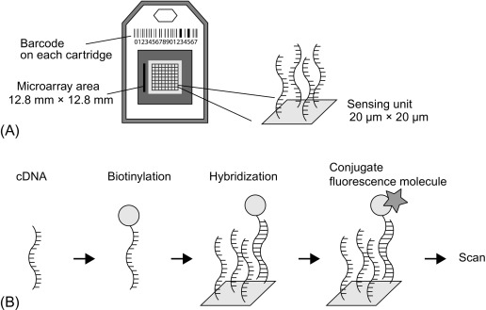
The data
Continuous data representing microarray signal intensities
Log-transformed and min/max normalized
Used the 16S rRNA gene to categorize microbiota [4]
1037 species or phylotypes
130 genus-like group

Slide 6
Hypotheses
H1: Increased gluten intake will affect the relative number of glutenase-producing microbiota
H2: Oligofructose consumption will affect gut microbiota composition differently than wheat or rye bread consumption.
Microbes may mediate gluten sensitivity
Lactobacilli
Aspergillus niger
Flavobacterium meningosepticum
Myxococcus xanthus
Sphingomonas capsulata
Oligofructose and inulin are both fructans, a group of specific carbohydrates found in wheat and rye.
can cause digestive issues for some

Slide 7
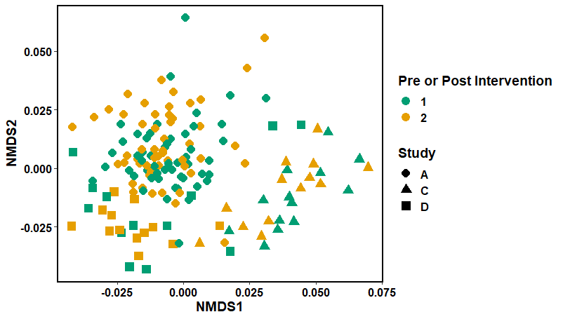
Non-metric Multi-dimensional Scaling
Iterative algorithm
Rank-based
Non-parametric
uses a distance matrix (Bray-Curtis) as input
BC considers species presence/absence, as well as abundance
The closer two points are, the more similar their microbiota composition

Slide 8
ANOSIM Test
H0: there is no difference between the microbial communities of the groups
Used 9999 permutations
And Bray–Curtis dissimilarity
used to quantify the compositional dissimilarity between two different sites
R(0-1): compares mean ranked dissimilarity between groups to mean ranked dissimilarity within groups.
1.0 = most dissimilar
0 = even distribution of high and low ranks within and between groups
 | ANOSIM statistic R | P - value
Pre/post | 0.0023 | 0.3027
Pre - AB/C/D | 0.6714 | <.0001
Post – AB/C/D | 0.6351 | <.0001
Pre – AB/C | 0.7996 | <.0001
Post – AB/C | 0.7566 | <.0001

Slide 9
Indicator Species Analysis
Genera Pre- intervention | Stat value | P-value
Roseburia intestinalis | 0.222 | 0.0068
Aeromonas | 0.217 | 0.0057
Micrococcaceae | 0.198 | 0.0149
Novosphingobium | 0.177 | 0.0314
Mitsuokella multiacida | 0.177 | 0.0275
Clostridium leptum | 0.163 | 0.0422
Akkermansia | 0.160 | 0.0474
Haemophilus | 0.157 | 0.0491
Identifies microbial species that are found more often in one group compared to another
Eubacterium’s are associated with opportunistic infections [6]
minor clinical importance
Genera Post-intervention
Eubacterium cylindroides | 0.161 | 0.0436

Slide 10
Discussion
Pre-intervention groups do not cluster together
General decrease in diversity
Proof of concept
Diet can alter the microbiome
Criticisms
Did not distinguish the individuals in study A from those in study B
Inconsistent data recording; pre/post measurements were not clearly indicated for study D
Did not distinguish male vs female subjects
No supplementary materials, only explanation for the dataset was a short description on data dryad
Non-obese and obese controls were used in their analysis but not included in the dataset
Study D only had 1 pre and 1 post measurement
Cholesterol, insulin resistance, and inflammation markers were measured but not included
Samples were processed differently
Notes:
Not a replicable study

Slide 11
References
Morgan, X. C. et al. Dysfunction of the intestinal microbiome in inflammatory bowel disease and treatment. Genome Biology 13, R79 (2012).
Hill, P., Muir, J. G. & Gibson, P. R. Controversies and Recent Developments of the Low-FODMAP Diet. Gastroenterol Hepatol (N Y) 13, 36–45 (2017).
Drago, S. et al. Gliadin, zonulin and gut permeability: Effects on celiac and non-celiac intestinal mucosa and intestinal cell lines. Scandinavian Journal of Gastroenterology 41, 408–419 (2006).
Jandhyala, S. M. et al. Role of the normal gut microbiota. World J Gastroenterol 21, 8787–8803 (2015).
Rajilić-Stojanović, M. et al. Development and application of the human intestinal tract chip, a phylogenetic microarray: analysis of universally conserved phylotypes in the abundant microbiota of young and elderly adults. Environ Microbiol 11, 1736–1751 (2009).
Eubacterium - an overview | ScienceDirect Topics. https://www.sciencedirect.com/topics/medicine-and-dentistry/eubacterium.
Image 2: Microarrays - an overview | ScienceDirect Topics.
Study: Korpela, K. et al. Gut Microbiota Signatures Predict Host and Microbiota Responses to Dietary Interventions in Obese Individuals. PLOS ONE 9, e90702 (2014).
Dataset: https://datadryad.org/stash/dataset/doi:10.5061/dryad.bv4k7

Slide 12
Questions?

